Slide 1
Ambari

Slide 2
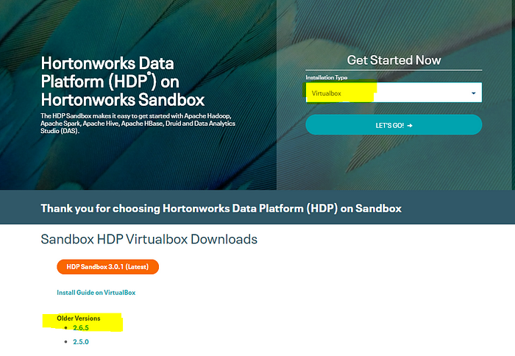

Slide 3
Once your Sandbox Image is ready to use, open it, and it should launch along with your Virtualbox. Click on ‘Import’ and wait for eternity.
After importing the sandbox image, click on Start. Let the CentOS import all layers.

Slide 4
To get started, make sure you have installed Oracle Virtualbox.
Download Hortonworks Sandbox Image to run on your Virtualbox. I use the 2.6.5 version. Select Installation Type as ‘Virtualbox.’ It takes a while to download (it is close to 15 GB)

Slide 5
Yayyy! You can now start exploring Hadoop Ecosystem. Now, let’s load data into HDFS.
To use the Ambari GUI, go to ‘localhost:1080’ and launch the dashboard.

Slide 6
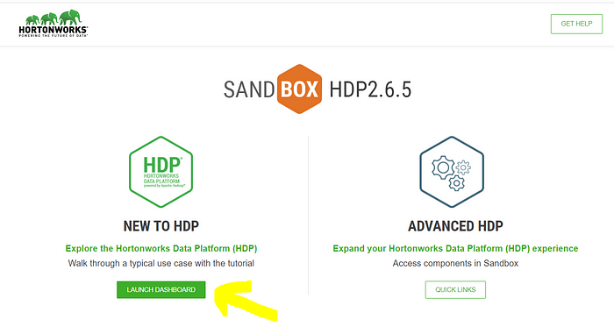

Slide 7
Log in using the following credentials. (These are the default credentials to log in to Ambari).
Username: maria_dev
Password: maria_dev

Slide 8

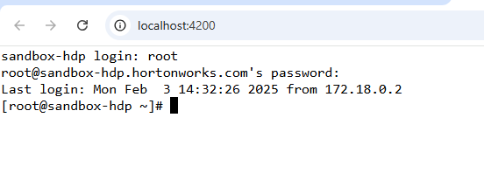

Slide 9
Ambari is a GUI to keep track of your Hadoop cluster. It is one of the ways to load data into HDFS. There are many other ways, one of them is to use CLI. I am assuming you’re a beginner and aren’t aware of any Hadoop commands. Hence, stick to Ambari for now.

Slide 10

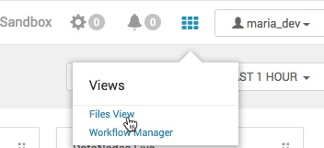
HDFS EXAMPLE
Download the sample sensor data either local or contained in a compressed (.zip) folder here: Geolocation.zip
Load the Sensor Data into HDFS
1. Logon to Ambari
2. Go to Ambari Dashboard and open Files View.

Slide 11
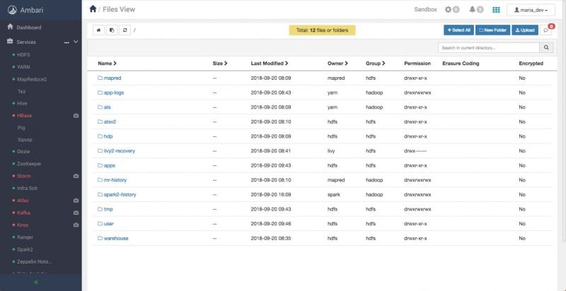
3. Start from the top root of the HDFS file system, you will see all the files the logged in user has access to see:

Slide 12
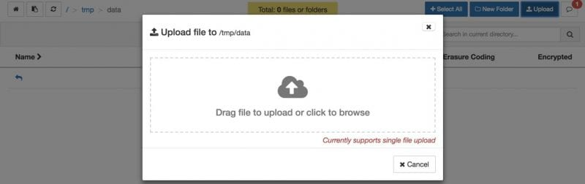
4. Navigate to `/tmp/` directory by clicking on the directory links.
5. Create directory data.
If you’re not already in your newly created directory path `/tmp/data`, go to the data folder.

Slide 13
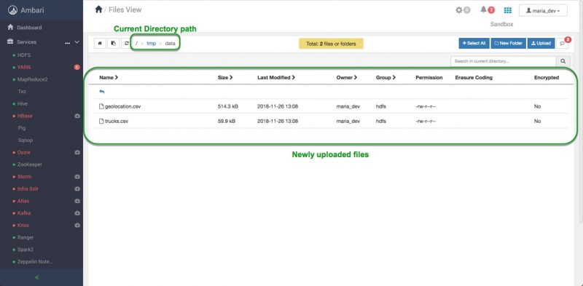
Both files are uploaded to HDFS as shown in the Files View UI:
You can also perform the following operations on a file or folder by clicking on the entity’s row: Open, Rename, Permissions, Delete, Copy, Move, Download and Concatenate.

Slide 14
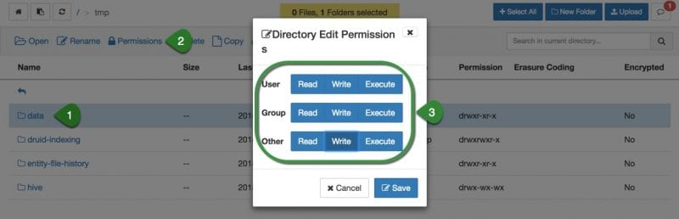

Slide 15
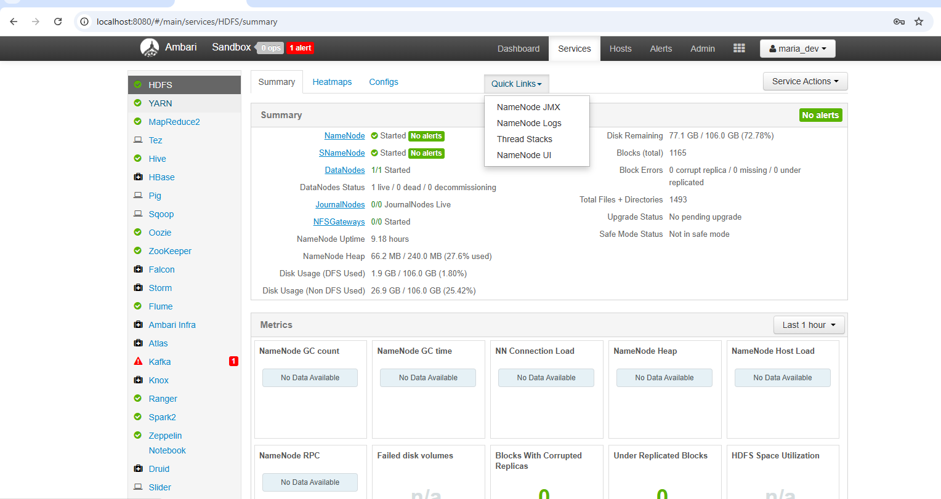

Slide 16
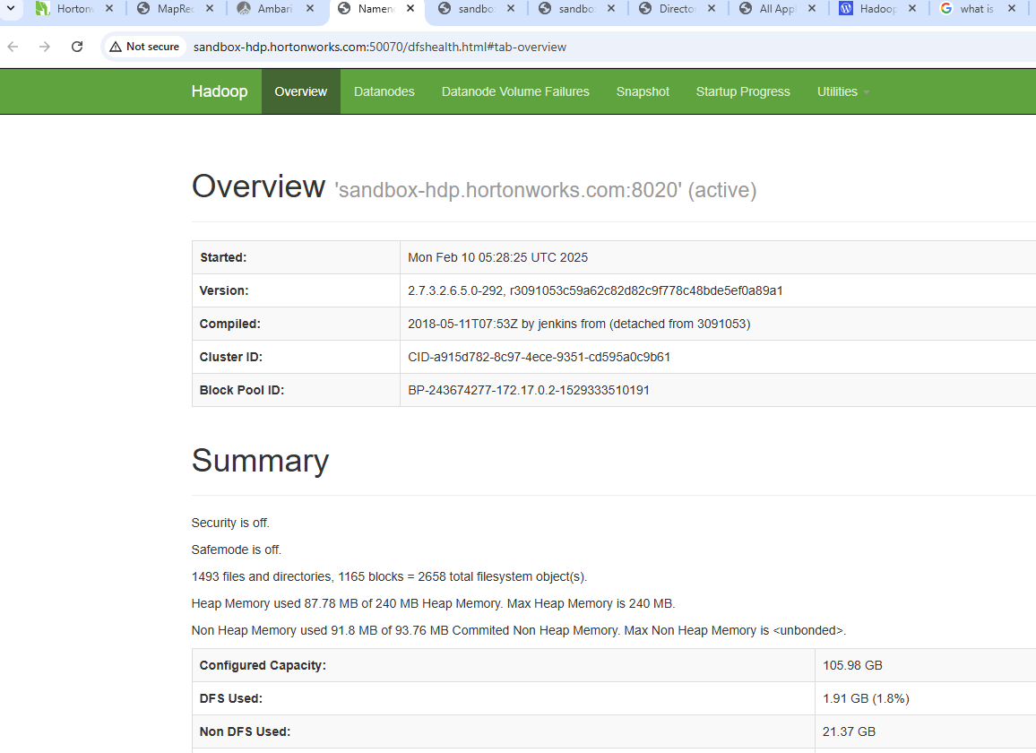

Slide 17
ETL tool
Hive
Map reducer

Slide 18
Hive: A data warehousing and SQL-like query language for Hadoop.
Pig: A high-level platform for creating MapReduce programs used for data analysis.
HBase: A NoSQL database that provides real-time, random read/write access to Hadoop data.
YARN: A resource management layer that allows different data processing engines to run on the same Hadoop cluster.

Slide 19
Hadoop consists of two primary components:
Hadoop Distributed File System (HDFS): HDFS is a distributed file system that stores data across multiple machines. It provides high fault tolerance and is designed to handle the storage needs of big data applications.
MapReduce: MapReduce is a programming model and processing engine that allows you to write code for processing and analyzing data in parallel across a Hadoop cluster or hadoop file. It’s particularly well-suited for batch-processing tasks.
MapReduce is a method for dividing computational tasks within the Hadoop file system. It consists of a job tracker and task tracker, where the job tracker assigns tasks to worker nodes, and the task tracker completes the tasks that assign CPU and memory for each worker node assigned by the job tracker.

Slide 20
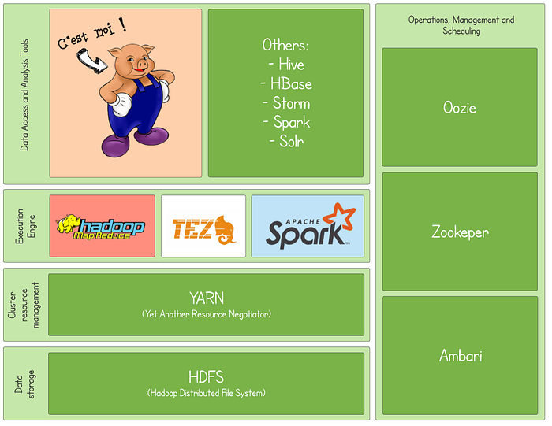

Slide 21
Query Hive Tables with Ambari Hive Views in HDInsight

Slide 22
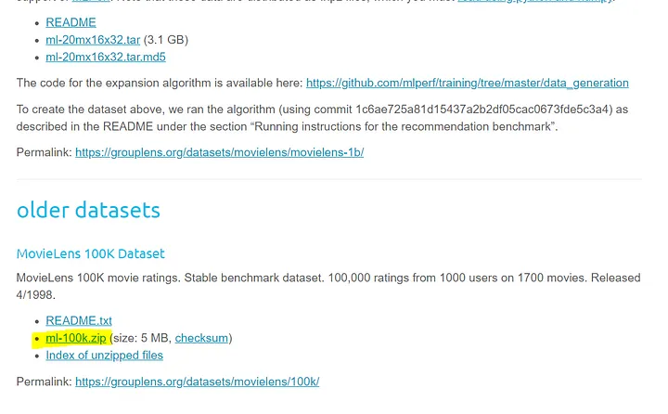
Till then, let’s download the MovieLens 100K dataset. Go to grouplens’ website and scroll down to find the MovieLens 100K dataset under older datasets. Click on ‘ml-100k.zip’ and extract all the files into a folder that is easy to navigate.

Slide 23
Keep the Data description in mind. Navigate to the extracted ml-100k folder on your local drive. Check the following files:
u.data -> tab-delimited data of movie ratings with columns: user_id, movie_id, rating, and timestamp.
u.item -> pipe-delimited data of movies with movie_id and moview_name, release_date, imdb_link, and other data about movie genres.

Slide 24
Hive
“Hive is a data warehouse infrastructure built on top of Hadoop. It provides tools to enable data ETL, a mechanism to put structures on the data, and the capability to query and analyze large data sets that are stored in Hadoop. The Hive View is designed to help you author, execute, understand, and debug Hive queries.”

Slide 25
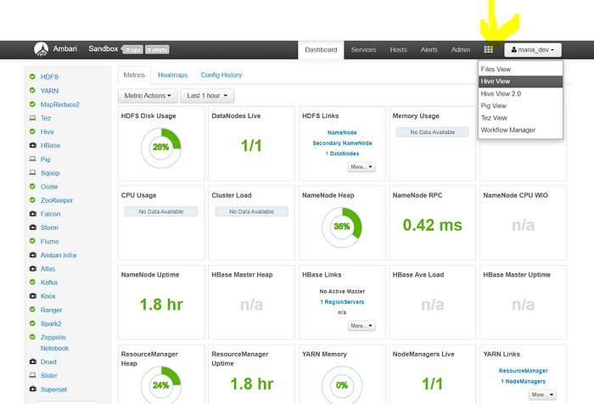
Step 9:
Now, you will see a bunch of technologies on the left.
Hover over the grid on the upper right corner and select ‘Hive View.’

Slide 26
Let’s import the ‘u.data’ file, which is our movie ratings data.
Click on ‘Upload Table.’ Let the file type be ‘CSV.’
Let’s change the delimiter to the TAB. Click on the little settings button and select 9 (ASCII value of TAB). Click on ‘Close.’

Slide 27
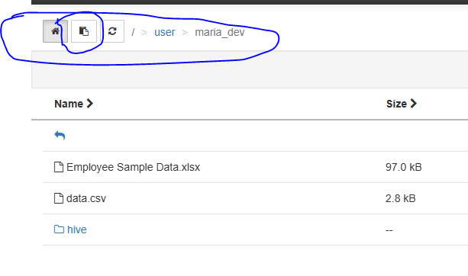
Upload from hdfs

Slide 28
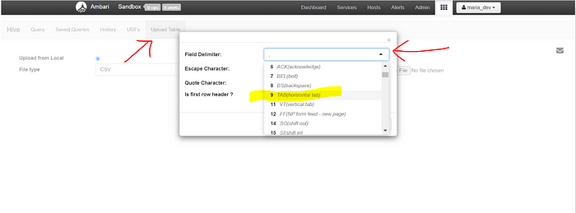

Slide 29
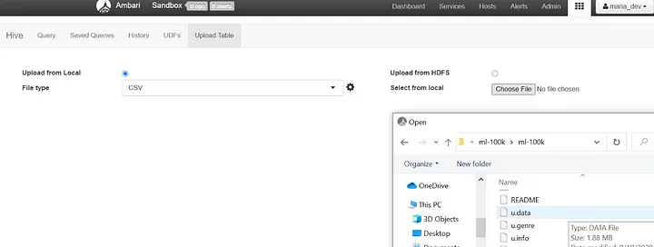
Step 11:
Click on ‘Choose File’ and navigate to the extracted ml-100k on your local drive. Locate the ‘u.data’ file and open it.

Slide 30
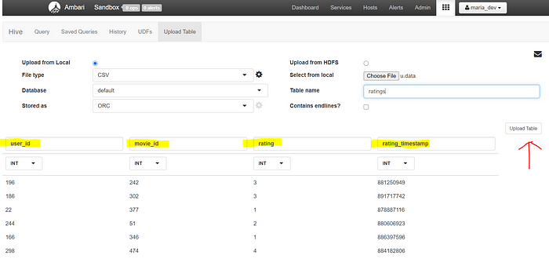
Step 12:
Assign a table name. Rename the columns and Upload the Table.

Slide 31
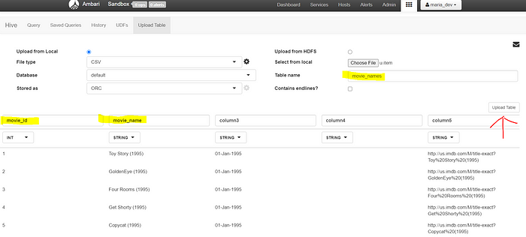
Step 13:
Follow the steps 10 to 12 and import the file ‘u.item’ which has ‘PIPE’ delimiter (ASCII 124).

Slide 32
You’ve successfully imported data into Hive and now you can go ahead Query this data as you do in an RDBMS.
you can go to Query Tab and hit the refresh icon. Expand the default database and tables to refer to the column names while querying your data.

Slide 33
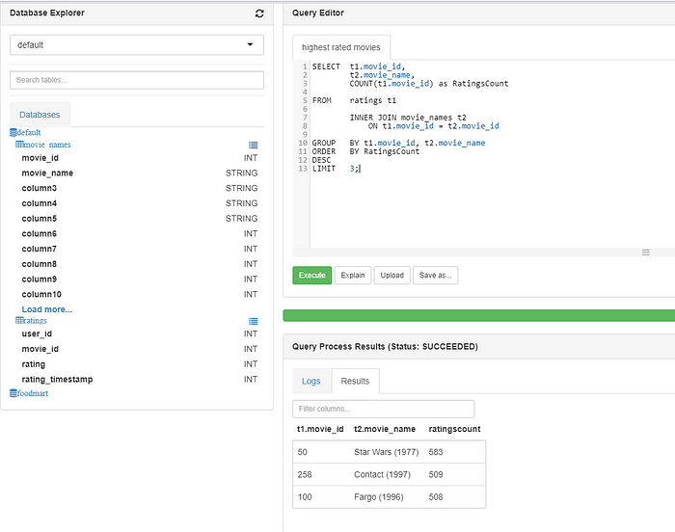
Which are the top three movies with the highest ratings in our database?

Slide 34
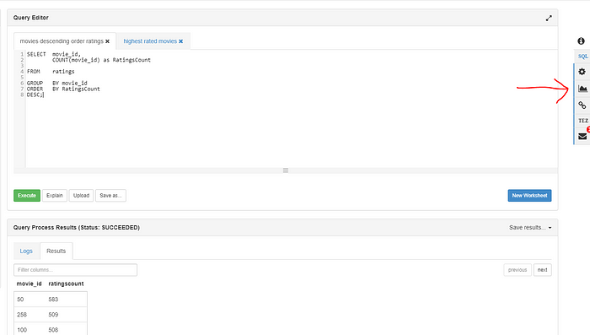
Wecan also Visualize the relationship between columns in our queries in Ambari.

Slide 35
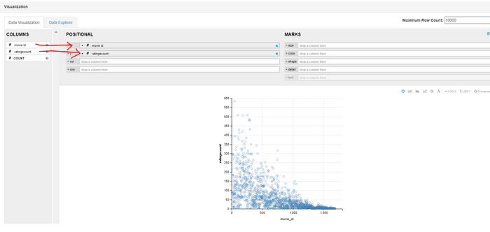
High rated movies seem to have a lower movie_id.

Slide 36
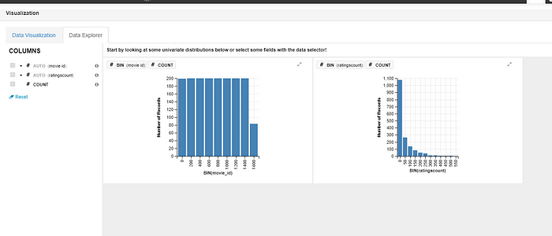
We have more records of low rated movies (0 to 50 rating).

Slide 37
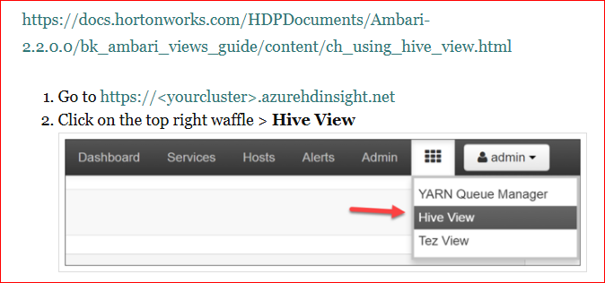

Slide 38
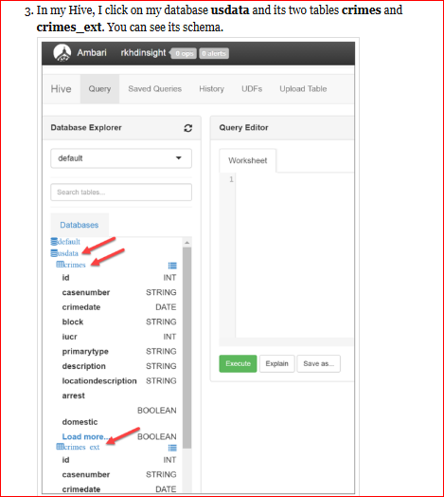

Slide 39
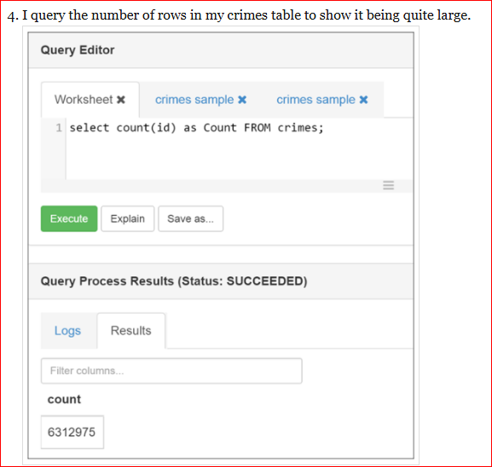

Slide 40
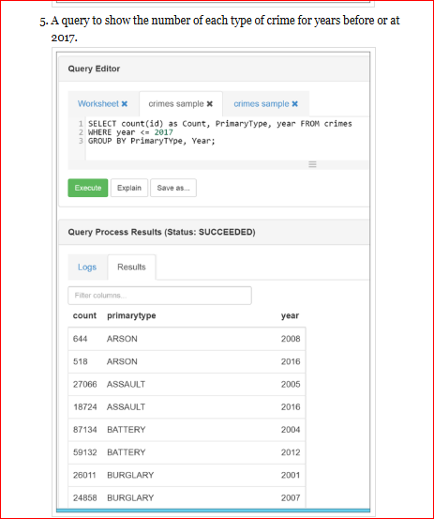

Slide 41
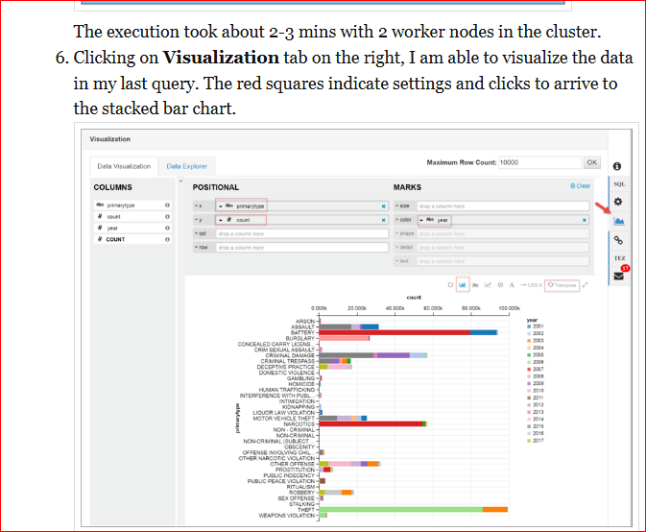

Slide 42
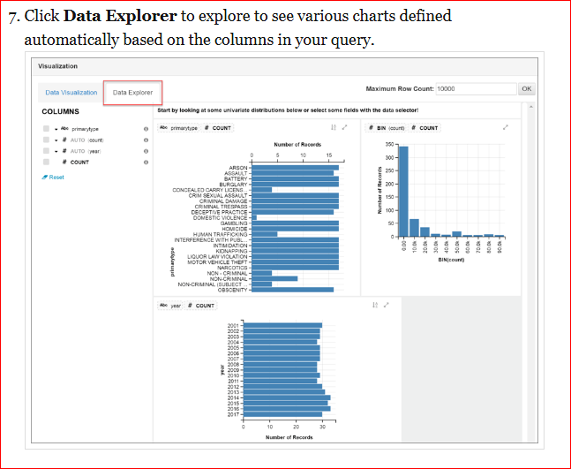

Slide 43
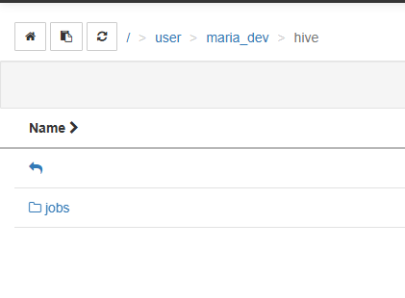
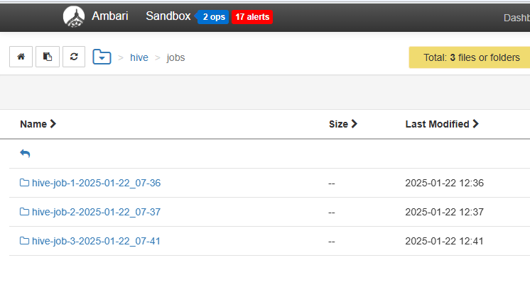
Check output in ambari folder

Slide 44
HDFS

Slide 45
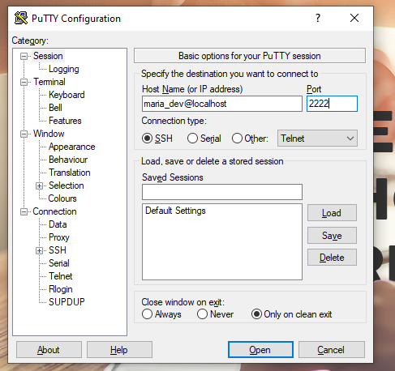
Download tool for connect sandbox to local machine
Download putty
Set hostname
maria_dev@localhost
Port
2222

Slide 46
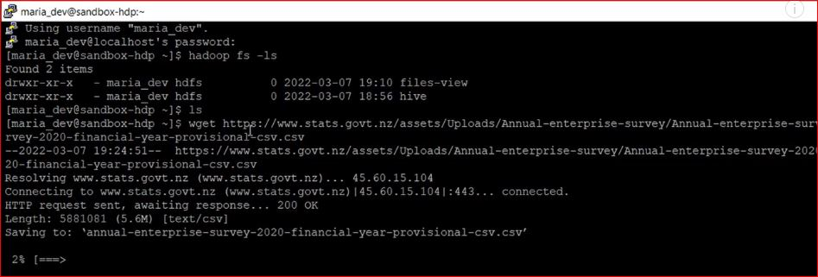
HDFS download online csv file

Slide 47
hdfs dfs -ls / find all folder in hdfs
hdfs dfs -rm -r /output remove output folder
rm /home/maria_dev/ratings.data
remove file from putty
rm -r /home/maria_dev/
Remove all folder from putty

Slide 48
Wget https://github.com/datasciencedojo/datasets/blob/master/titanic.csv
Dwonload from drive
wget --no-check-certificate 'https://drive.google.com/uc?export=download&id=1B26Ulj29eXedsNI3XObxz35D_NRGIHV5' -O most.py
wget --no-check-certificate 'https://drive.google.com/uc?export=download&id=1B26Ulj29eXedsNI3XObxz35D_NRGIHV5' -O data.txt
Ls use for single node file list
Hadoop fs –ls for hdfs file list ambari
hadoop fs -mkdir mydrive create drive in hdfs ambari
Move file from local to ambari
hadoop fs -copyFromLocal most.py mydrive/most.py

Slide 49
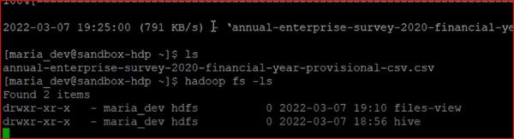

Slide 50
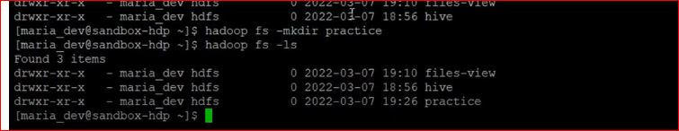

Slide 51
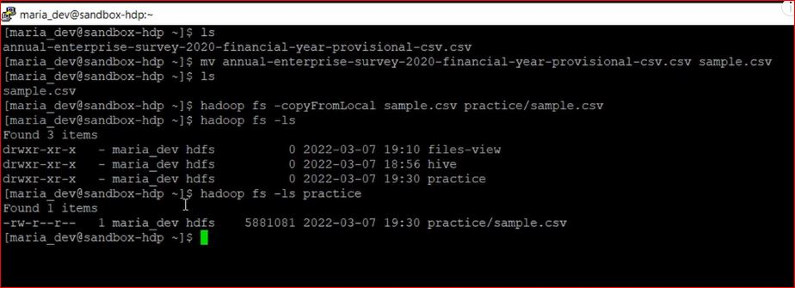

Slide 52
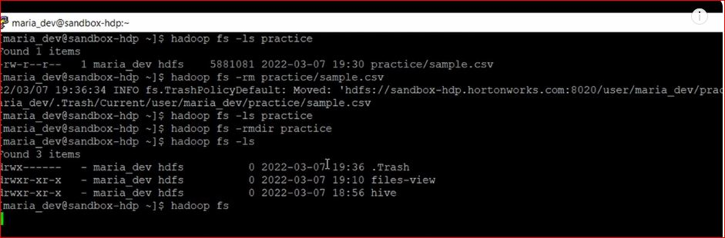

Slide 53
wget https://raw.githubusercontent.com/datasciencedojo/datasets/master/titanic.csv
ls -l titanic.csv
hdfs dfs -mkdir -p /user/maria_dev/datasets
hdfs dfs -ls /user/maria_dev/
hdfs dfs -put titanic.csv /user/maria_dev/datasets/
hdfs dfs -ls /user/maria_dev/datasets/
hdfs dfs -cat /user/maria_dev/datasets/titanic.csv | head -n 10

Slide 54
What is MapReduce?
MapReduce is a distributed execution framework that processes large-scale data by dividing it into smaller chunks for parallel processing tasks.
It’s a big data processing model that allows simplified data processing on large clusters.
The MapReduce System uses the ‘map’ step to filter and sort the data, followed by the ‘reduce’ step to perform summary operations.

Slide 55
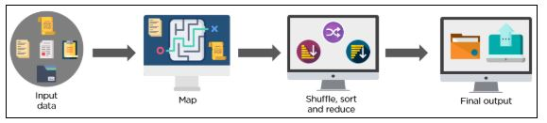
Fun Fact: The MapReduce System was originally developed by Google and is a core component of Hadoop, an open-source framework for distributed storage and processing of large data sets.

Slide 56
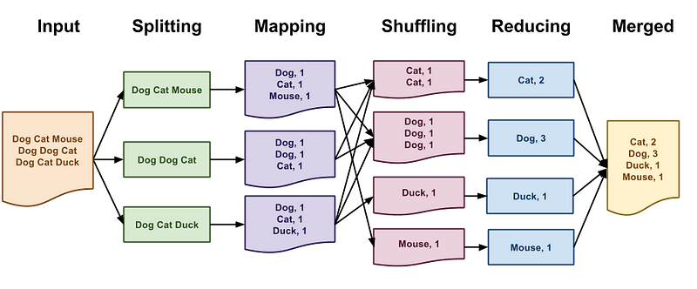
Word count Example

Slide 57
The components of Hadoop include:
The Hadoop Distributed File System (HDFS) for storing data across clusters.
YARN for managing resources and job scheduling.
MapReduce for distributed programming.
In MapReduce, the mapping step applies the transformation logic to data, followed by the reduce phase for aggregating data. Worker nodes, responsible for executing tasks and communicating with the master node, play a crucial role in the Hadoop system.

Slide 58
1. Map Phase
Mapping Step: The initial phase where input data is divided into smaller chunks and processed in parallel processing tasks.
Redundant Input Data: Duplicate input data is identified and grouped together to ensure efficient processing.
2. Shuffle and Sort Phase
Shuffle Phase: During this phase, the output from the Single Red is transferred to the reducers. The framework ensures that all the values for a particular key end up at the same reducer.
Sort Phase: Once the data is shuffled, it is sorted based on keys. This step ensures that the data received by each reducer is sorted and grouped by keys.

Slide 59
3. Reduce Phase
Aggregating data: The Reduce phase aggregates the intermediate key-value pairs generated during the Map phase into a smaller set of output key-value pairs.
Output data: The final output of the Reduce phase is the processed and aggregated data ready for further analysis or storage.
The Reduce phase calculates the final Output Values based on the aggregated data and the specified reduce function.

Slide 60
How to Write a MapReduce Program?
Understand the problem: Identify the input and output formats, and define the map and reduce functions.
Write the map function: Implement the logic to perform mapreduce operations and apply functional programming concepts.
Write the reduce function: Use SQL-like statements to process the intermediate key-value pairs and produce the final output.
Test the program: Validate the MapReduce program with different input data sets and analyze the results.

Slide 61
ETL Processes
Data Mapping: Extract data from various relational systems and perform the mapping step to structure it for processing.
Transformation Logic: Apply ETL processes to transform the extracted data using specific business rules or logic.
Data Loading: Load the transformed data into the target system for analysis and reporting purposes.
When conducting ETL processes, ensure efficient data mapping, precise transformation logic, and seamless data loading to maximize the benefits of MapReduce in Hadoop.

Slide 62
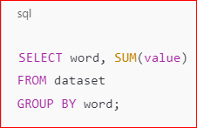
When to Use Hive?
Hive is an SQL-like abstraction over Hadoop, making it easier to work with large datasets without writing complex code. It’s best for: ✅ Structured Data: If your data is structured and follows a relational model. ✅ Batch Processing: When dealing with batch queries that don’t require complex transformations. ✅ Ease of Use: If you prefer writing SQL-like queries instead of writing MapReduce code.
This does exactly what your MapReduce code does but in one line using Hive.

Slide 63
When to Use MapReduce?
MapReduce gives low-level control over distributed computing, making it ideal for:
✅ Unstructured Data: If you’re processing logs, images, or JSON that don’t fit well in tables.
✅ Complex Transformations: When SQL is not enough, such as machine learning, graph processing, and custom aggregations.
✅ Efficiency & Performance: When you need optimized performance, MapReduce can be fine-tuned better than Hive.
✅ Custom Processing Logic: If you need more control over how data is split, shuffled, and reduced.

Slide 64
💡 Example Use Cases:
Analyzing website clickstream data (JSON logs, not structured SQL tables)
Machine Learning model training (where iterative computations are required)
Processing IoT sensor data in real-time

Slide 65
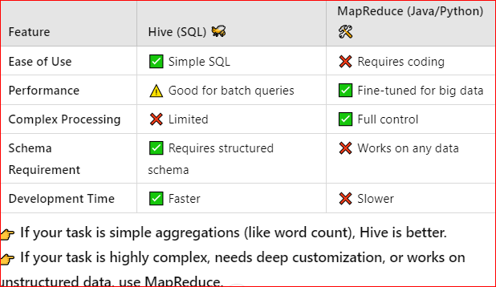
🚀 Which One Should You Use?

Slide 66
If your goal is simple summation & grouping (like word count), use Hive because it’s easier and faster. But if you want full control over processing or working with non-tabular data, use MapReduce.

Slide 67
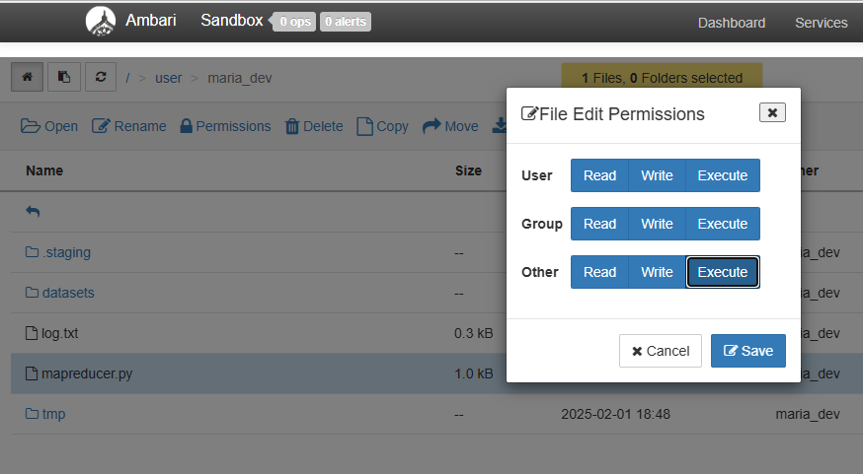

Slide 68
Go to ambari terminal and pate this command to check file exist or not
[maria_dev@sandbox-hdp root]$ hdfs dfs -ls
Found 5 items
drwx------ - maria_dev hdfs 0 2025-02-01 13:24 .staging
drwxr-xr-x - maria_dev hdfs 0 2025-02-01 15:06 datasets
-rwxrwxrwx 1 maria_dev hdfs 282 2025-01-31 11:59 log.txt
-rw-r--r-- 1 maria_dev hdfs 983 2025-02-03 07:57 mapreducer.py
drwxr-xr-x - maria_dev hdfs 0 2025-02-01 13:48 tmp

Slide 69
Installing mrjob on HDP 2.6.5 (be sure to "su root" first, as shown in the video.)
su root
And change the password by default password is hadoop
yum-config-manager --save --setopt=HDP-SOLR-2.6-100.skip_if_unavailable=true
yum install https://repo.ius.io/ius-release-el7.rpm https://dl.fedoraproject.org/pub/epel/epel-release-latest-7.noarch.rpm
yum install python-pip
curl https://bootstrap.pypa.io/pip/2.7/get-pip.py -o get-pip.py
python get-pip.py
pip install pathlib
pip install mrjob==0.7.4
pip install PyYAML==5.4.1
yum install nano

Slide 70
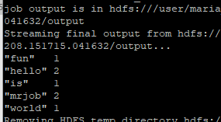
Map reducer example
using MRJob that counts the occurrences of words in a text file.
wget https://raw.githubusercontent.com/sajidasahrmeen11/hadoop/main/map.py
And download input.txt from github
Now run on Hadoop with given command
python map.py -r hadoop --hadoop-streaming-jar /usr/hdp/current/hadoop-mapreduce-client/hadoop-streaming.jar input.txt

Slide 71
MapReduce Example
Find the most visited page by the user
wget https://raw.githubusercontent.com/sajidasahrmeen11/hadoop/main/mmo.py
And download lo.txt from github
python mmo.py -r hadoop --hadoop-streaming-jar /usr/hdp/current/hadoop-mapreduce-client/hadoop-streaming.jar lo.txt
Ls use for single node file list
Hadoop fs –ls for hdfs file list ambari
hadoop fs -mkdir mydrive create drive in hdfs ambari
Move file from local to ambari
hadoop fs -copyFromLocal most.py mydrive/most.py

Slide 72
MapReduce Example 1
Analyzing Movie Ratings data to get the most popular ratings

Slide 73
wget https://raw.githubusercontent.com/ashaypatil11/hadoop/main/ratings.data
wget https://raw.githubusercontent.com/ashaypatil11/hadoop/main/MovieRatings.py
Running locally:
python MovieRatings.py ratings.data
Running on Hadoop cluster:
python MovieRatings.py -r hadoop --hadoop-streaming-jar /usr/hdp/current/hadoop-mapreduce-client/hadoop-streaming.jar ratings.data

Slide 74
Example 2
Get the most popular movie from a dataset

Slide 75
wget https://raw.githubusercontent.com/ashaypatil11/hadoop/main/TopMovies.py
wget https://raw.githubusercontent.com/ashaypatil11/hadoop/main/ratings.data
Running locally:
Ls
python TopMovies.py ratings.data
Running on Hadoop cluster:
python TopMovies.py -r hadoop --hadoop-streaming-jar /usr/hdp/current/hadoop-mapreduce-client/hadoop-streaming.jar ratings.data

Slide 76
ETL
wget https://raw.githubusercontent.com/sajidasahrmeen11/hadoop/main/etll.py
And download lo.txt from github
Python etll.py -r hadoop --hadoop-streaming-jar /usr/hdp/current/hadoop-mapreduce-client/hadoop-streaming.jar lo.txt

Slide 77
https://medium.com/towards-data-science/interview-with-apache-pig-theory-and-practical-guide-6c44f06a4ca9
https://o.onslip.net/HDPDocuments/Ambari-2.2.1.0/bk_ambari_views_guide/content/section_write_pig_scripts_pig_view.html

Slide 78
What is YARN?
The processed data will be stored in /output/part-00000 in HDFS.
YARN (Yet Another Resource Negotiator) is Hadoop's resource management system. It helps in:
Job scheduling → Assigns computing tasks across different Hadoop nodes.
Resource allocation → Manages memory, CPU, and other resources efficiently.
Parallel execution → Allows multiple MapReduce jobs to run simultaneously.
YARN will manage and execute the Hadoop Streaming job.
The job progress and logs can be monitored in YARN Resource Manager UI
Localhost:8088

Slide 79
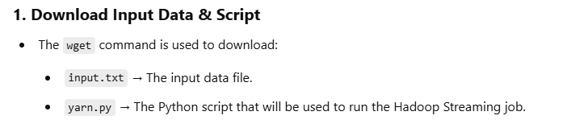
YARN task
This task involves setting up and executing a Hadoop Streaming job using Python on HDFS (Hadoop Distributed File System) and managing it with YARN (Yet Another Resource Negotiator). The steps include:

Slide 80
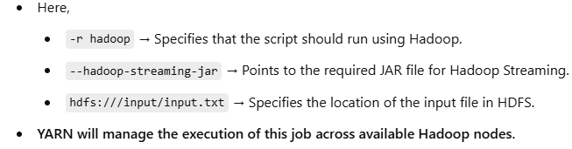
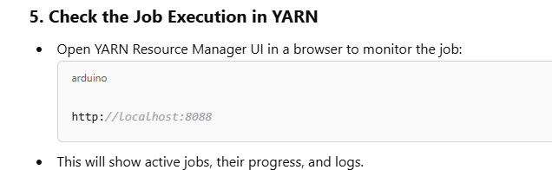
Execute Hadoop Streaming Job with YARN
YARN is responsible for resource management and job scheduling in Hadoop.
The Python script yarn.py is executed with the following command:
python yarn.py -r hadoop --hadoop-streaming-jar /usr/hdp/2.6.5.0-292/hadoop-mapreduce/hadoop-streaming-2.7.3.2.6.5.0-292.jar hdfs:///input/input.txt

Slide 81
YARN
wget https://raw.githubusercontent.com/sajidasahrmeen11/hadoop/main/input.txt
wget https://raw.githubusercontent.com/sajidasahrmeen11/hadoop/main/yarn.py
hdfs dfs -mkdir /input
hdfs dfs -put input.txt /input/
find / -name "hadoop-streaming*.jar"
python yarn.py -r hadoop --hadoop-streaming-jar /usr/hdp/2.6.5.0-292/hadoop-mapreduce/hadoop-streaming-2.7.3.2.6.5.0-292.jar hdfs:///input/input.txt

Slide 82
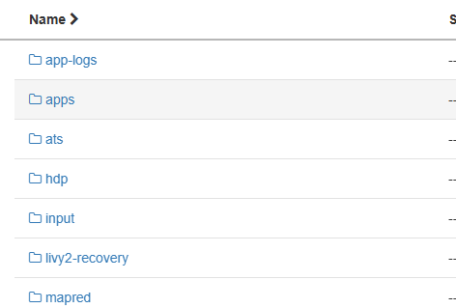
Input folder create after command run

Slide 83
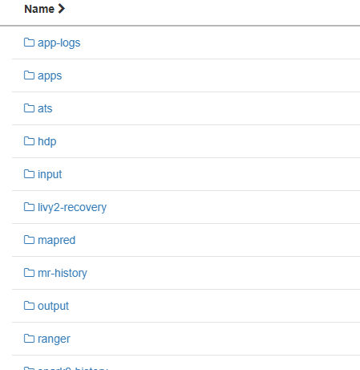
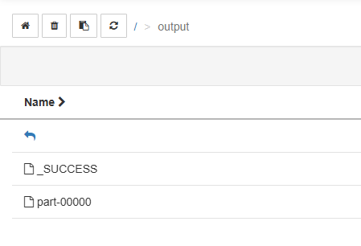
python yarn.py -r hadoop --hadoop-streaming-jar /usr/hdp/2.6.5.0-292/hadoop-mapreduce/hadoop-streaming-2.7.3.2.6.5.0-292.jar -o hdfs:///output hdfs:///input/input.txt

Slide 84
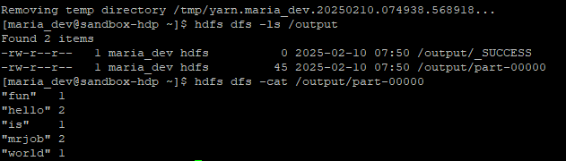
http://localhost:8088
hdfs dfs -ls /output
hdfs dfs -cat /output/part-00000

Slide 85
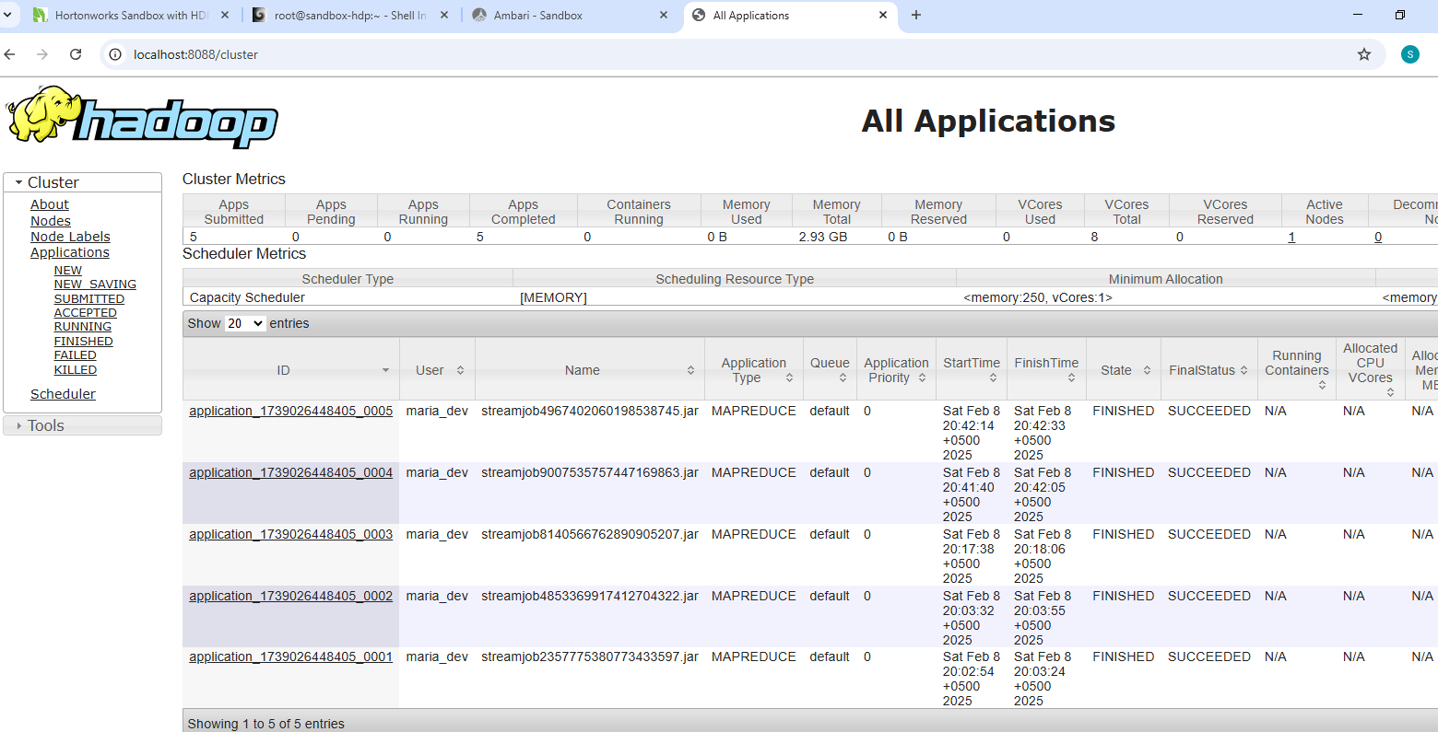

Slide 86
Check logs in YARN
yarn logs -applicationId <application_id>
yarn logs -applicationId application_1739165825858_0002

Slide 87
Apache Pig
Apache Pig is an integral component of the Hadoop ecosystem. Since his birth more than a decade ago, he has helped thousands of analysts around the world make sense of massive data sets. Despite his importance, few people outside of the big data sector have heard of him, and some who are acquainted with him have only vague idea about his usage , programming language — and Grunt⁠ —interactive shell

Slide 88


Slide 89
On the other hand, when It run on either Tez or Spark, It will convert the logic expressed in a Pig Latin code into a data structure known as Directed Acyclic Graphs (DAGs). The word “directed” in DAG means that all the data flow to one direction, while the word “acyclic” means that DAGs can’t contain any loop. Here is an illustration of DAG:

Slide 90


Slide 91
When creating a DAG, It will ensure that the steps are ordered in a way that optimizes computation. For example, let’s say we have a script that contains a JOIN operation followed by a FILTER step. It will investigate whether the FILTER step can be done before the JOIN step. If yes, It will perform the FILTER step prior to the JOIN step, thus reducing the number of data points to be joined (JOIN is a computationally expensive operation!) Because of the power of DAGs, pigrunning on Tez or Spark always leads to better performance compared to MapReduce.

Slide 92
ETL in pig
People use pig for two things: extract-transform-load (ETL) pipelines and ad-hoc queries.
A typical ETL pipeline loads in a data from a source, clean it, transform it and store it somewhere. An example is the processing of log data of a particular website. Using my FILTER function, one can clean these logs by filtering out data coming from automatic bots and internal views. it can also perform transformations that enrich the original log data. For instance, It can group these log data by the countries that the visitors hail from to provide more fine-grained view of the data.

Slide 93
Other common use case is research and ad-hoc queries. Traditionally, these are done using SQL. However, if the data set to be queried is unstructured and contains “complications” such as nested structures and missing values, It may be a better tool. Pig flexibility and extendability lend themselves well for such cases.

Slide 94


Slide 95


Slide 96


Slide 97
use Pig Latin scripting language
Breakdown:
Apache Pig:
A high-level data processing framework that runs on Hadoop.
It processes large-scale datasets using MapReduce or Tez as the execution engine.
Best suited for structured and semi-structured data processing.

Slide 98
Pig Latin:
A scripting language used in Apache Pig.
It has a declarative syntax similar to SQL but works on the Hadoop Distributed File System (HDFS).
It is used to load, transform, and analyze large datasets efficiently.
Execution Engine:
Default: MapReduce (Runs on Hadoop).
Alternative: Tez (For faster execution).
Local Mode: Can run on a local machine for small datasets.

Slide 99
Example Pig use titanic .csv find survived and not survived passenger
titanic = LOAD '/user/maria_dev/titanic.csv'
USING PigStorage(',')
AS (PassengerId:int, Survived:int, Pclass:int, Name:chararray, Sex:chararray, Age:float, SibSp:int, Parch:int, Ticket:chararray, Fare:float, Cabin:chararray, Embarked:chararray);
-- Survived aur Not Survived passengers ko group karna
groupedBySurvival = GROUP titanic BY Survived;
-- Har group ke liye average age calculate karna
avgAge = FOREACH groupedBySurvival GENERATE group AS SurvivedStatus, AVG(titanic.Age) AS AvgAge;
-- Output ko dekhna
DUMP avgAge;

Slide 100


Slide 101


Slide 102

ETL example using sales dataset

Slide 103
-- **Step 1: Extract Data**
sales = LOAD '/user/maria_dev/
USING PigStorage(',') sales_data.csv'
AS (TransactionID:int, Date:chararray, CustomerID:int, ProductID:int, Amount:float);
-- **Step 2: Transform Data**
-- Filter transactions where Amount > 200
highValueSales = FILTER sales BY Amount > 200;
-- Group by CustomerID to calculate total spending per customer
salesByCustomer = GROUP highValueSales BY CustomerID;
-- Calculate total sales per customer
customerSales = FOREACH salesByCustomer GENERATE
group AS CustomerID,
SUM(highValueSales.Amount) AS TotalSpent;
-- **Step 3: Load Data**
STORE customerSales INTO '/user/maria_dev/output/customer_sales'
USING PigStorage(',');
-- View output in the console
DUMP customerSales;

Slide 104
ETL Breakdown:
Extract
Loads the sales_data.csv file from HDFS using PigStorage(',’).
Transform
Filters out transactions where Amount > 200.
Groups data by CustomerID.
Computes total sales per customer using SUM().
Load
Saves the transformed data to HDFS (/user/maria_dev/pig/output/customer_sales).

Slide 105
Example 2
ls
wget https://raw.githubusercontent.com/ashaypatil11/hadoop/main/ratings.data
wget https://raw.githubusercontent.com/ashaypatil11/hadoop/main/movies.item
hdfs dfs -mkdir pig
hdfs dfs -copyFromLocal ratings.data pig/ratings.data
hdfs dfs -copyFromLocal movies.item pig/movies.item

Slide 106
Pig script
ratings = LOAD '/user/maria_dev/pig/ratings.data' AS (userID:int, movieID:int, rating:int, ratingTime:int);
metadata = LOAD '/user/maria_dev/pig/movies.item' USING PigStorage('|')
AS (movieID:int, movieTitle:chararray, releaseDate:chararray, videoRealese:chararray, imdblink:chararray);
nameLookup = FOREACH metadata GENERATE movieID, movieTitle,
ToUnixTime(ToDate(releaseDate, 'dd-MMM-yyyy')) AS releaseTime;
ratingsByMovie = GROUP ratings BY movieID;
avgRatings = FOREACH ratingsByMovie GENERATE group as movieID, AVG(ratings.rating) as avgRating;
fiveStarMovies = FILTER avgRatings BY avgRating > 4.0;
fiveStarsWithData = JOIN fiveStarMovies BY movieID, nameLookup BY movieID;
oldestFiveStarMovies = ORDER fiveStarsWithData BY nameLookup::releaseTime;
DUMP oldestFiveStarMovies;

Slide 107


Slide 108
Now let’s go to the meat of the question. If both Hive and I can perform data analysis, why is there a need to have both of us? In other words, what are the differences between us? Here are my answer to that:

Slide 109
Language. Hive uses HiveQL, a variant of the familiar query language a programming language SQL while I use Pig Latin, a procedural language. Pig Latin is more extendable than SQL⁠⁠ — one can import Python or Java functions to broaden Pig Latin’s functions. There are other differences between Pig Latin and SQL, which I will elaborate later.
Input data. Hive imposes schema on the data it processes, thus can only handle structured data. Meanwhile, as I mentioned before, I can handle structured, semi-structured or unstructured data.

Slide 110
Target user. Because Hive uses a language similar to standard SQL, it is targeted for users who are already comfortable with the latter, namely data analysts. These data analysts mainly use Hive for periodic reporting. Meanwhile, Pig Latin is more powerful but takes a bit more time to get used to. As such, I am more suited to programmers, data engineers and researchers that can apply me for the use cases I mentioned previously.

Slide 111
My language, Pig Latin, is a procedural language that describes data transformation. It does not natively support loops and only have limited support for IF/THEN constructs, which are sometimes necessary.
I can only perform basic data analysis and can only return textual/numerical results. If you want to perform more sophisticated data exploration, such as ones that involve making visualizations, or build a machine learning model, then I am not the right guy! For this, my buddy Spark will be more appropriate.

